Slide 1
Raj Patel
2121020
Phone Website

Slide 2
About Website
Here customer can buy phone.
Customer can check information of any phone.
There is address and map location is also mention in website so customer can visit.
Contact details are also available.

Slide 3
Html tags
Frame tag is used to make frame in webpage.
Marquees tag is used to show shop’s name.
P tag is used to make paragraph.
H tag is used to write heading.

Slide 4
Css tag
Margin tag is used to set margin in webpage.
Colour tag is used to set colour in webpage.

Slide 5
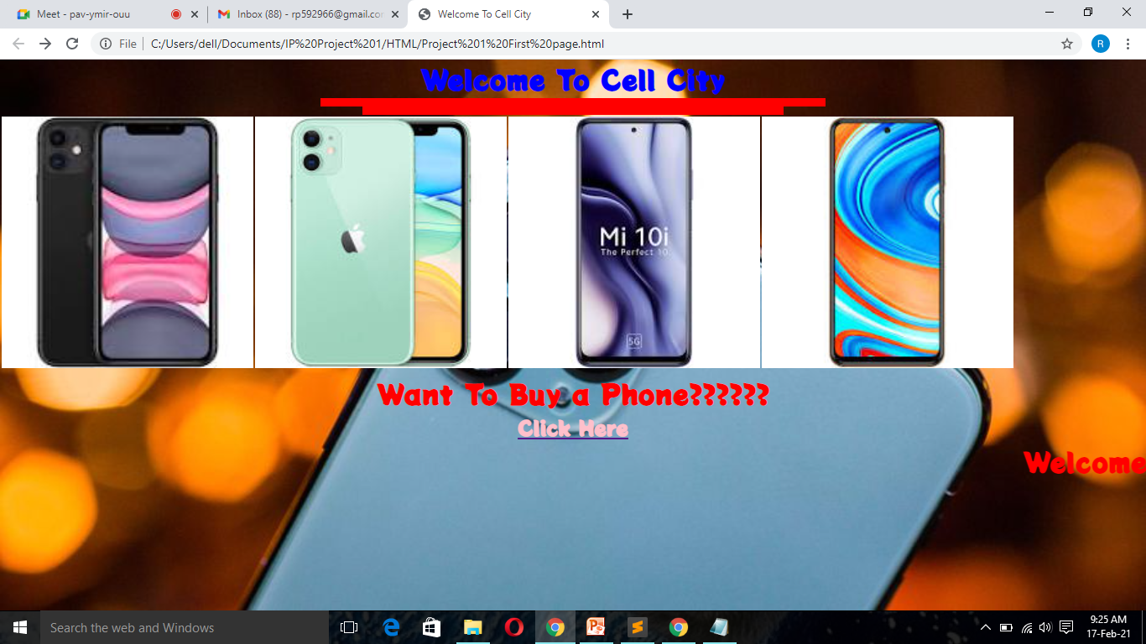
First Page of Website

Slide 6
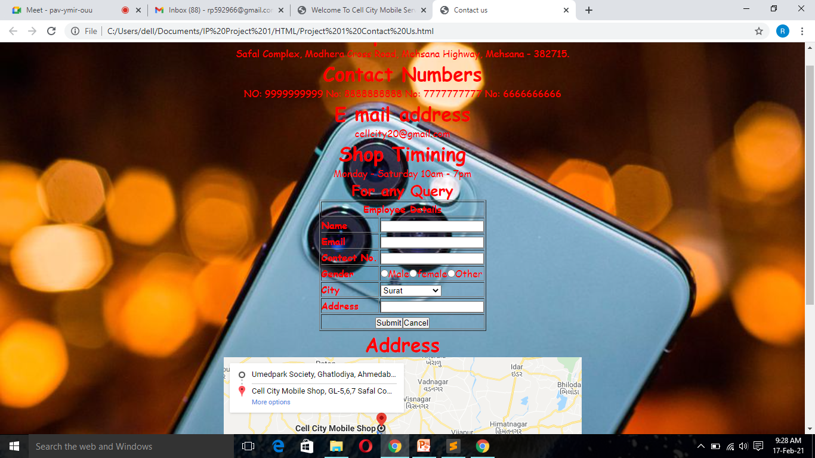
Contact us page

Slide 7
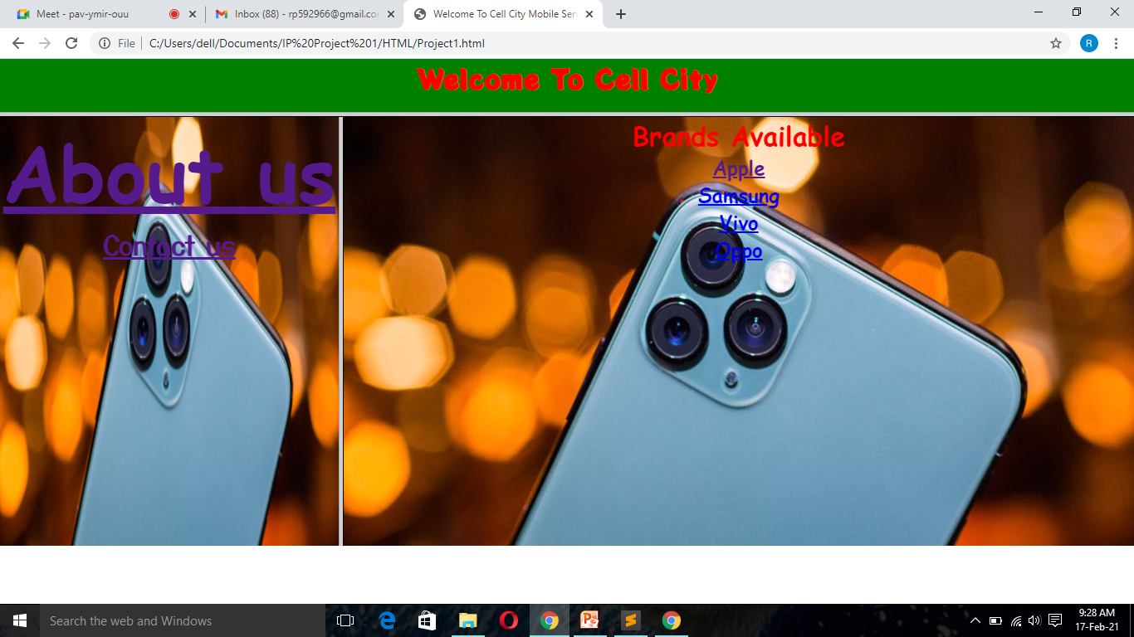
Brands Available

Slide 8
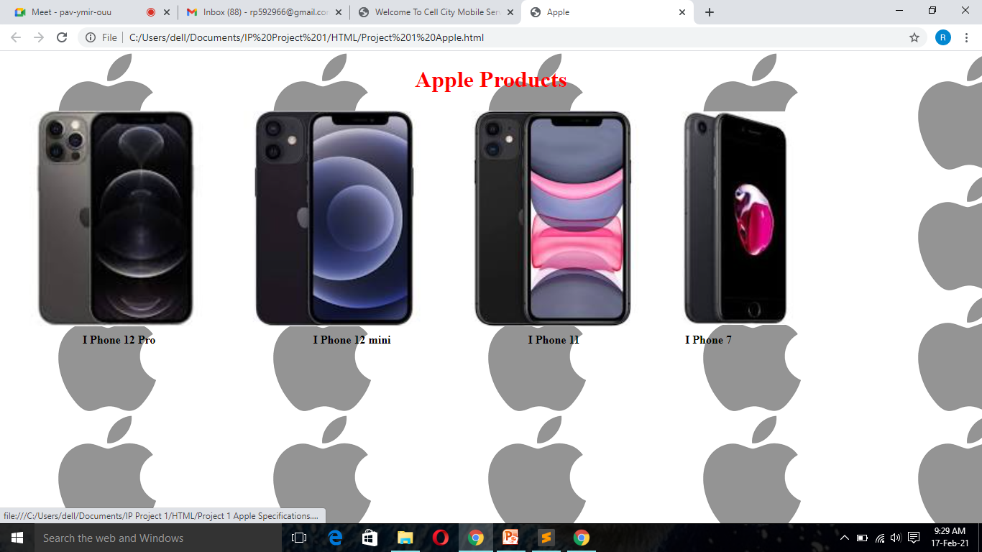
Products and it’s specification

Slide 9
Thank You

